Slide 1


team MINDACTIVITY
2022 Demo Day

Slide 2
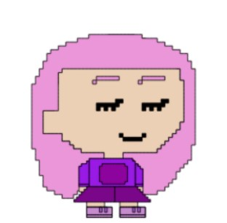
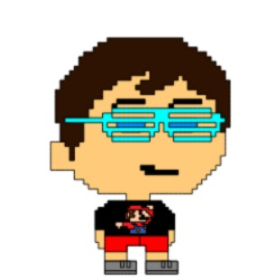
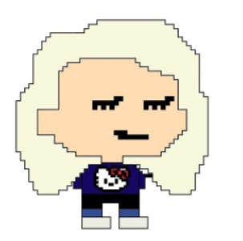
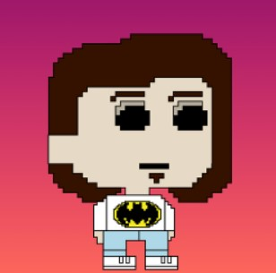
Meet the Team
Sadie
Ed
Philip
Anastasia

Slide 3
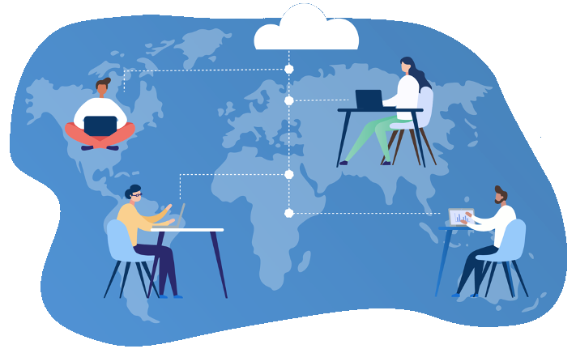

PROBLEM
How to enhance the remote experience of a bootcamper.
What can help them with the vast amount of learning?
What do they need?
What problem might they have that your application could solve for them?
How can you get into the mindset of your user and keep them at the centre of your problem-solving?

Slide 4
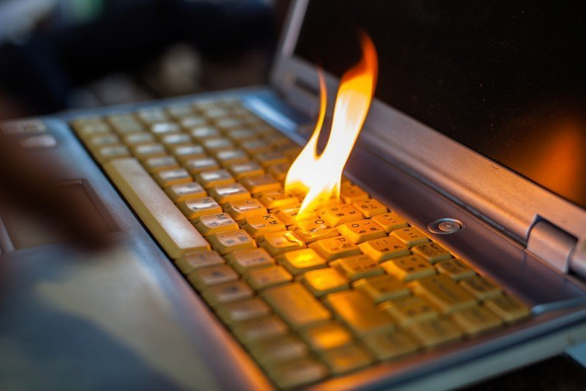

Bootcamp Burnout

Slide 5
MINDFULLNESS + PRODUCTIVITY = MINDACTIVITY

Slide 6
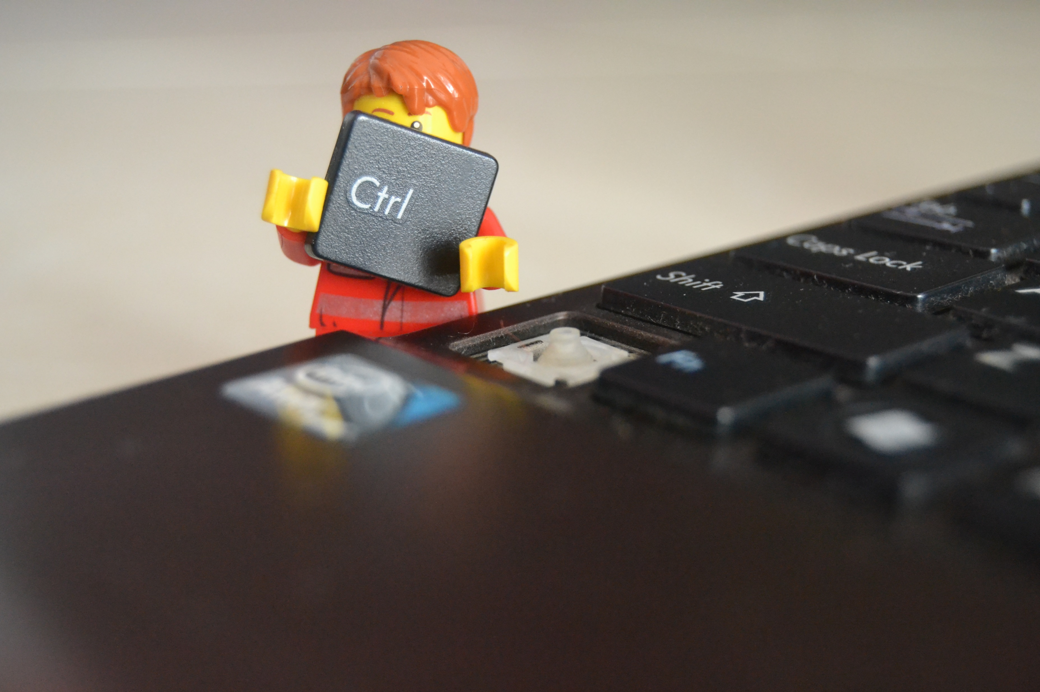
SOLUTION

Slide 7
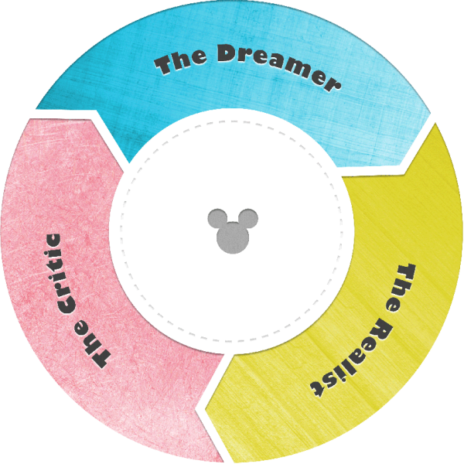
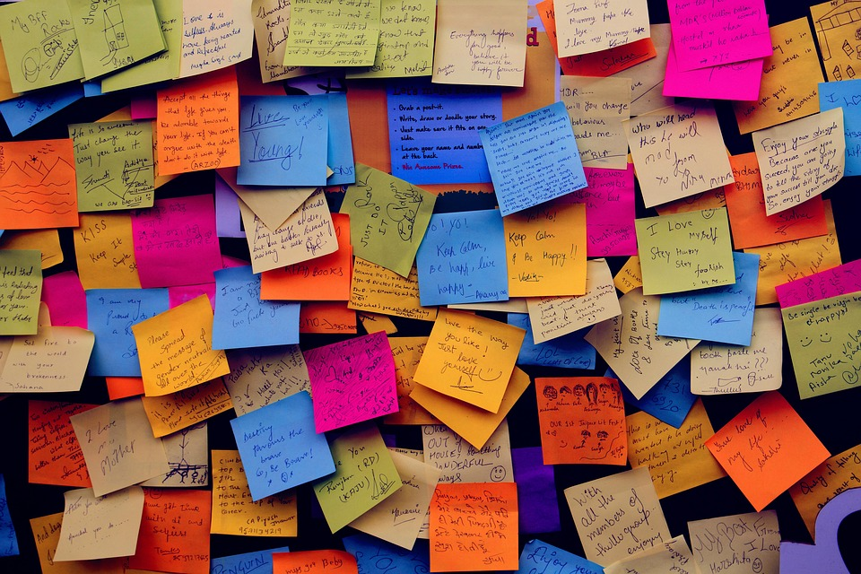
JOURNEY IDEATION & RESEARCH

Slide 8
Disney Ideation
Dreamer | Realist | Critic
Organisation Tools | Link to class notes, link to videos | No experience with audio API
Resources Access | Daily planner | Time constraints
Timer with gentle affirmations | ARIA html | When in doubt, stretch goal it
Personal assistant/tutor | Accessibility tools | More research needed
#Istruggletoo | API for affirmations | No experience with animations
Blog feature | Heroku database | External API vs Internal API
To-do List | High contrast website | Blog requires more than one user
Reminder | Nature sounds | Login authentication issues
Link App to Apple Watch | Mental health resources | Lack of originality

Slide 9
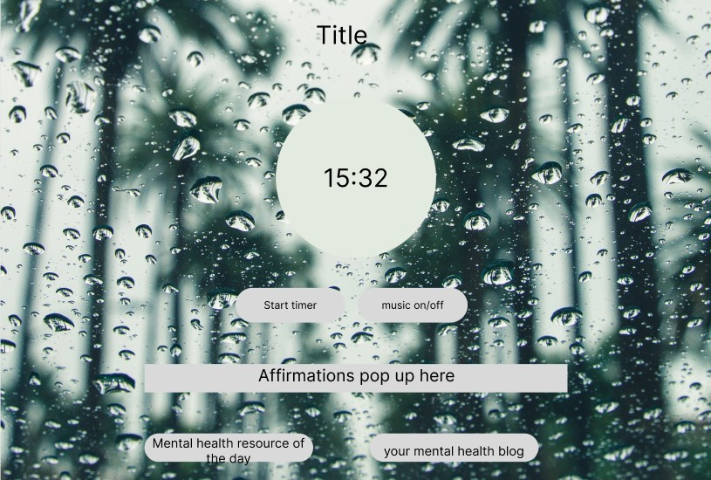

Slide 10
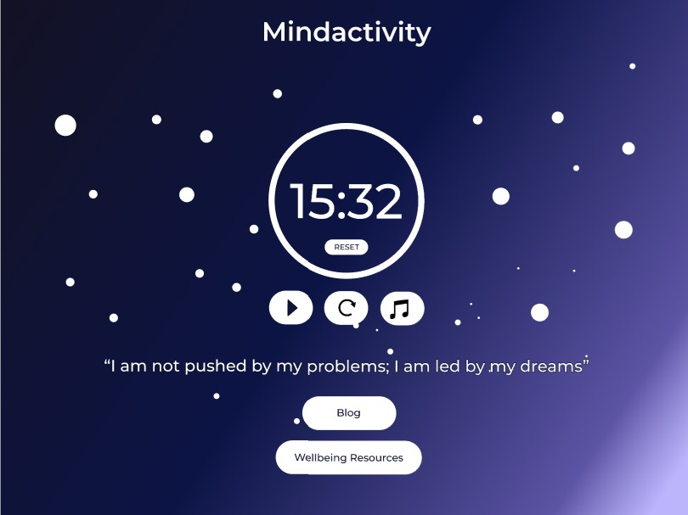

Slide 11
USER SURVEY
Flow chart

Slide 12
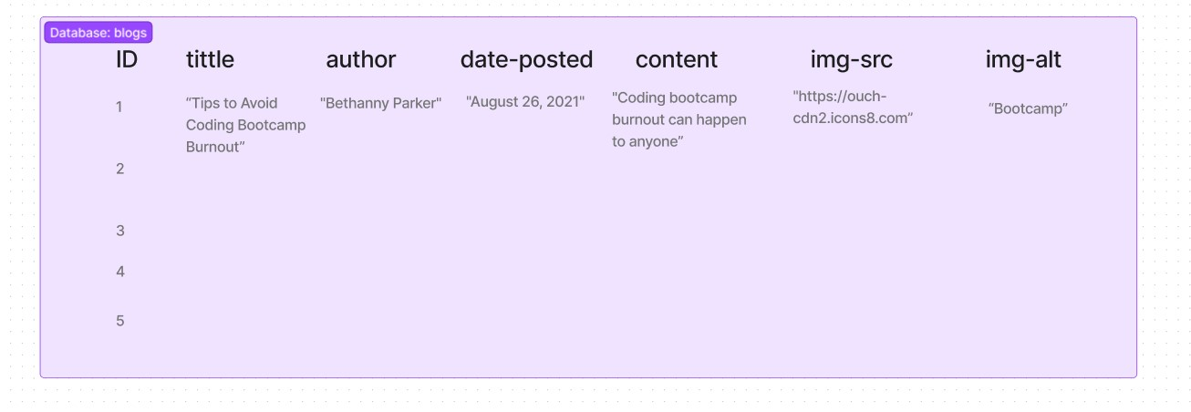
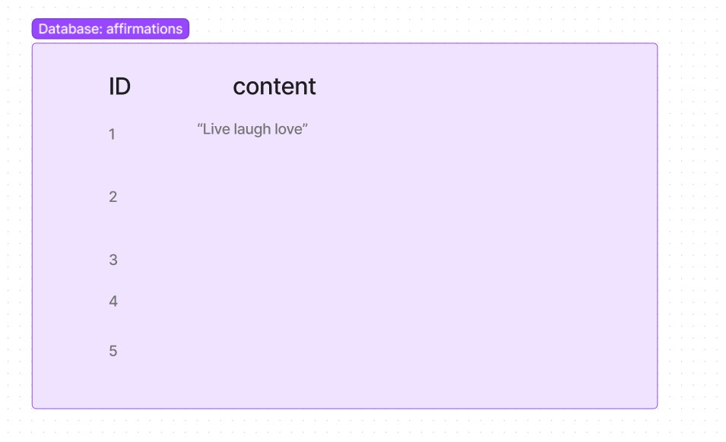
Database Structure

Slide 13
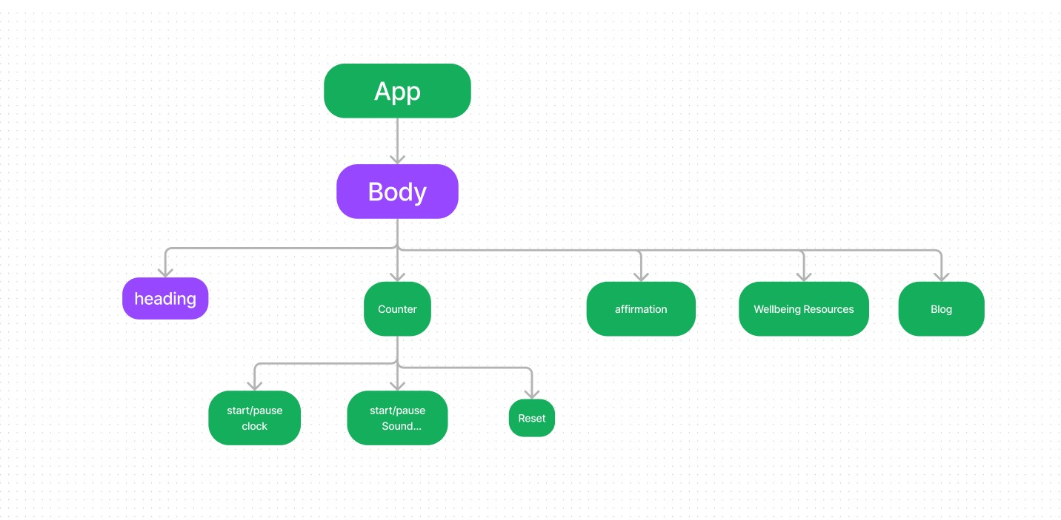
Component Tree

Slide 14
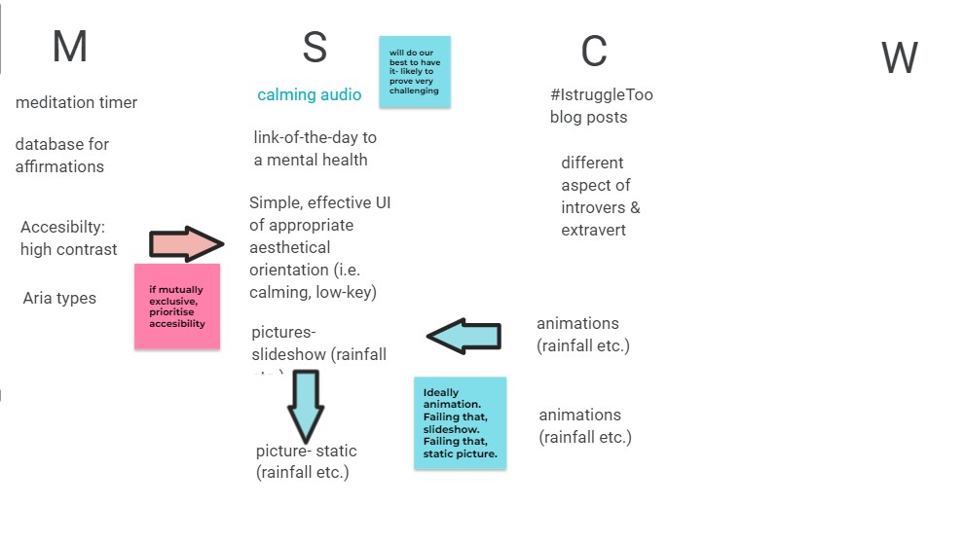
MoSCoW to MVP

